Slide 1
TEST CASES

Slide 2
Test cases
Learning Objectives
Structure of Test Cases
Sample Test Cases

Slide 3
Test scenario
A Scenario is any functionality that can be tested. It is also called Test Condition or Test Possibility.
A scenario is an idea from which we can derive possible test cases on particular functionality.

Slide 4
Test cases
A case that tests the functionality of specific object.
Test case is a description of what to be tested, what data to be given and what actions to be done to check the actual result against the expected result.
It is document which includes step description of i/p, o/p conditions with test data along with expected results.

Slide 5
Characteristics of good test cases
A good test case should have the following:
TC should start with “what you are testing”.
TC should be independent.
TC should not contain “If” statements.
TC should be uniform.

Slide 6
A good test case
Finds faults
Effective
Exemplary Evolvable
Economic
Represents others
Easy to maintain
Cheap to use

Slide 7
Issues to be considered
All the TCs should be traceable.
There should not be too many duplicate
test cases.
Out dated test cases should be cleared off.
All the test cases should be executable

Slide 8
Structure of test cases
It contains:
Identifier: A unique identifier of test case
Test Case Author/creator i.e. name of tester
Version of current test case
Name of the test case to identify test case purpose and scope.
Type of testing
Purpose: short description of test case i.e. what functionality it checks

Slide 9
Structure of test cases
Testing environment/configuration: Hardware and software configuration.
Pre-requisite: Initial condition
Finalization: Action to be done after test case is performed. E.g. if test case crashes the data base, tester should restore it before other test cases will be performed.
Input data description
Expected results

Slide 10
Test case template
Test case ID | Test case Name | Objective / Description | Pre-Requisite / Pre-Condition
Steps to be Followed / Steps to be reproduced | Test data | Expected Result | Actual Result | Status (Pass/Fai l)

Slide 11
Sample test cases
Preconditions:
Open Web browser and enter the given url in the address bar.
Home page must be displayed.
All test cases must be executed from this page.

Slide 12
Sample test cases
Test case ID | Test case Name | Objective / Descripti on | Pre- Requisite / Pre- Condition | Steps to be Followed / Steps to be reproduced | Test data | Expec ted Resul t | Act ual Res ult | Stat us (Pas s/Fa il)
TC00 1 | Login (OK Butto n) | To Check whether user can log in successful ly. | Yahoo Page should be opened | Enter the Valid Username. Enter the Valid Password. Click OK button. | UN:: mind PWD:: scripts | Shoul d login Succe ssfull y. | Sa me as ER | Pass

Slide 13
Test cases review
Peer to peer Reviews
Team Lead Review
Team Manager Review

Slide 14
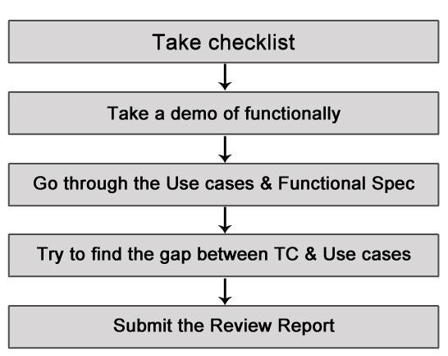
Review process

Slide 15
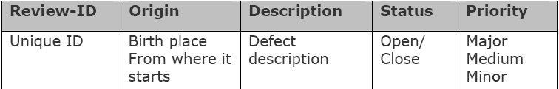
Review format

Slide 16
Test case execution
Execution and execution results plays a vital role in the testing. Each and every activity should have proof.
The following activities should be taken care:
Number of test cases executed.
Number of defects found
Screen shots of successful and failure executions
should be taken in word document.
Time taken to execute.
Time wasted due to the unavailability of the system.

Slide 17
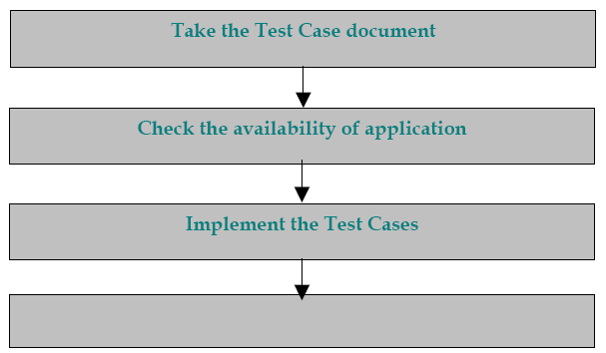
Test case execution process
Inputs
-Test Cases
-System Availability
-Data Availability
Process
-Test it.
Output
-Raise the Defects
-Take screen shot & save it
Raise the Defects

Slide 18
Interview questions
Write a test case on a pen / fan / table.
What is a Test Case?
What are the parameters included in test case
template ?
Explain Test Case Execution Process .
In a Login page what will be test procedure, test
scenario, test description & test steps?

Slide 19

Any questions?

